Slide 1
Delivery: Shipping Restrictions
How to bring us forward!
Understanding Shipping Policies

Slide 2

Training are not an expense, but an investment in Human Capital
Transcom
Roy H Williams, 2001
|

Slide 3
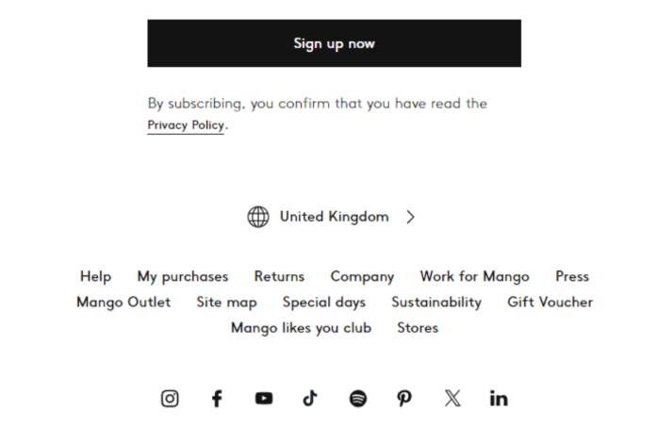

Country/Region Selection
Rule: Shipping addresses must correspond with the country/region selected at the time of order.
Example 1: If “Spain (Peninsula and Balearic Islands)” is selected, you cannot ship to the Canary Islands, Ceuta, or Melilla.
Example 2: If “United Kingdom” is selected, you cannot ship to the Channel Islands.
Temporary Unavailability: Shipping options, stores, or collection points might be temporarily unavailable due to logistical reasons.
Examples of Unavailability: Store renovations, temporarily closed collection points, suspension of express/urgent shipping during high order volumes.
|

Slide 4
Order Restrictions and Delivery Limitations
Order Value Limit: Online orders cannot exceed €1,500.
Order Item Limit: Online orders cannot contain more than 40 items.
Large Orders: For orders exceeding these limits, refer to the “Online Experience FAQ Purchase of large amounts” article.
Prohibited Addresses: We do not ship to military bases or PO boxes.
Requirement: A valid street address is required for delivery.
|

Slide 5
Hazardous Goods (Cosmetics) Shipping Policy
Some countries have restrictions on shipping hazardous goods, especially cosmetics like perfumes that contain flammable substances.
Full Country/Region Restriction: If an entire country or a specific region within the country selector (e.g., Canary Islands, Channel Islands, French Guiana) is fully restricted, cosmetics will not appear available for sale.
Partial Area Restriction: If an area without its own selector (e.g., Azores, Madeira Islands) is restricted, cosmetics will appear available but will trigger a message at checkout.
|

Slide 6
Hazardous Goods (Cosmetics) Shipping Policy
Checkout Message and Options (Partial Restriction):
The message will state that these products cannot be shipped to the address.
Customers will be given two options:
Continue the purchase without the hazardous goods.
Modify the shipping address.
Removal and Redirection:
If continuing without hazardous goods, they will be removed from the shopping bag.
If the order contains only hazardous goods and the address is restricted, the customer will be redirected to the homepage.
|

Slide 7
Let´s be brilliant together!
Quality and Training Team Mango and Transcom,
April 2025
|

